Slide 1

Event Sync
JG University | BCA – Semester 5 | Division-E

Slide 2
Team Members
Fahad Shaikh (1452) (TL)
Krish Gohil (1416)
Harsh Darji (1417)
Rudra Padhiyar (1437)
Ikrama kathiyara (1426)

Slide 3
OVERVIEW
The Event Management System is a digital platform designed to simplify the organization, participation, and discovery of events. It supports two types of events: Group Events, where a group of users collaboratively plans an event without a designated host, and Hosted Events, which are created and managed by a single user and open for public registration. The system aims to make event planning more collaborative, transparent, and efficient, while also improving user engagement and attendance management.

Slide 4
Purpose and need..
Event planning today is often fragmented across different platforms (social media, messaging apps, spreadsheets), making collaboration, scheduling, and attendance tracking difficult. There is also a lack of systems that support equal group collaboration in event planning — most platforms are designed around single-host or corporate events. This system fills that gap by offering a unified platform that handles both public and collaborative group events.
Problem Statement :
Lack of collaboration tools: Existing platforms often don’t support events planned by groups without a single host.
Disorganized scheduling: People often forget events or struggle to keep track of dates and times spread across different apps.
Limited control and participation management: Event organizers lack easy tools to manage attendees, limit participants, or verify entry (solved by QR passes).

Slide 5
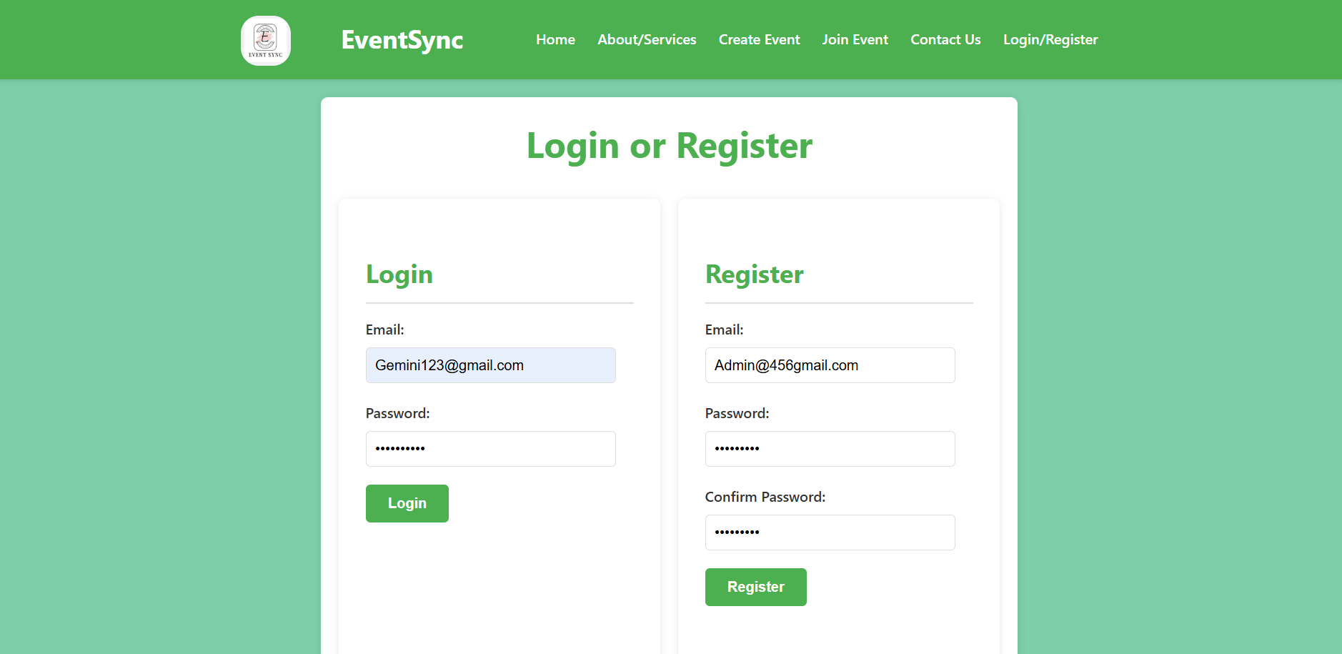
Login or Register
MAJOR: INTERIOR DESIGN

Slide 6
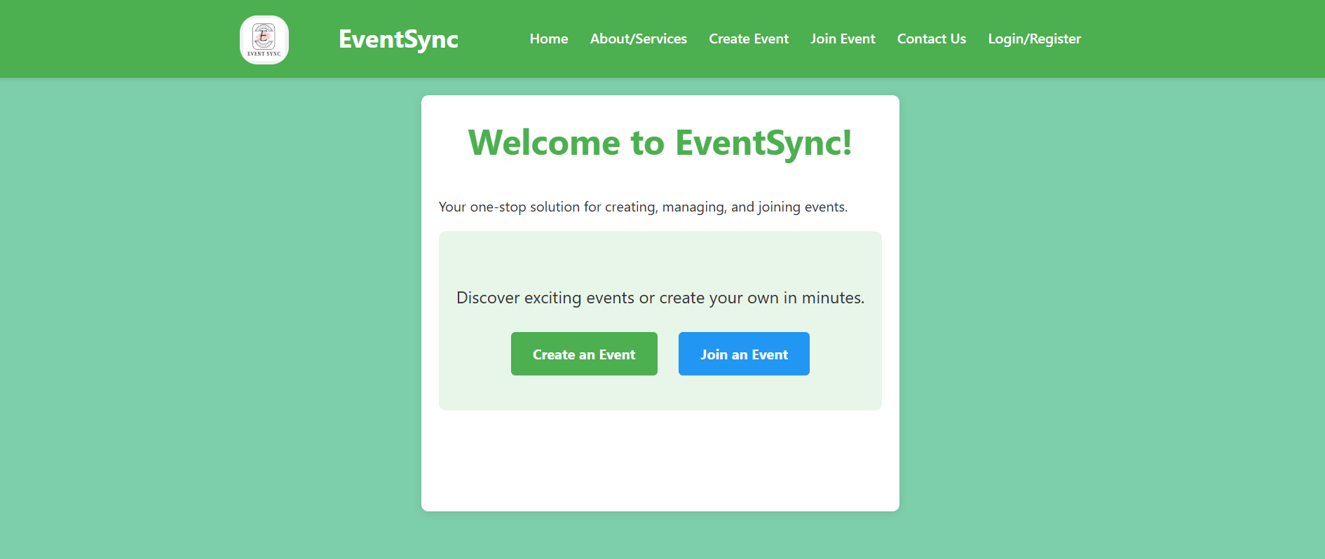
Home
MAJOR: INTERIOR DESIGN

Slide 7
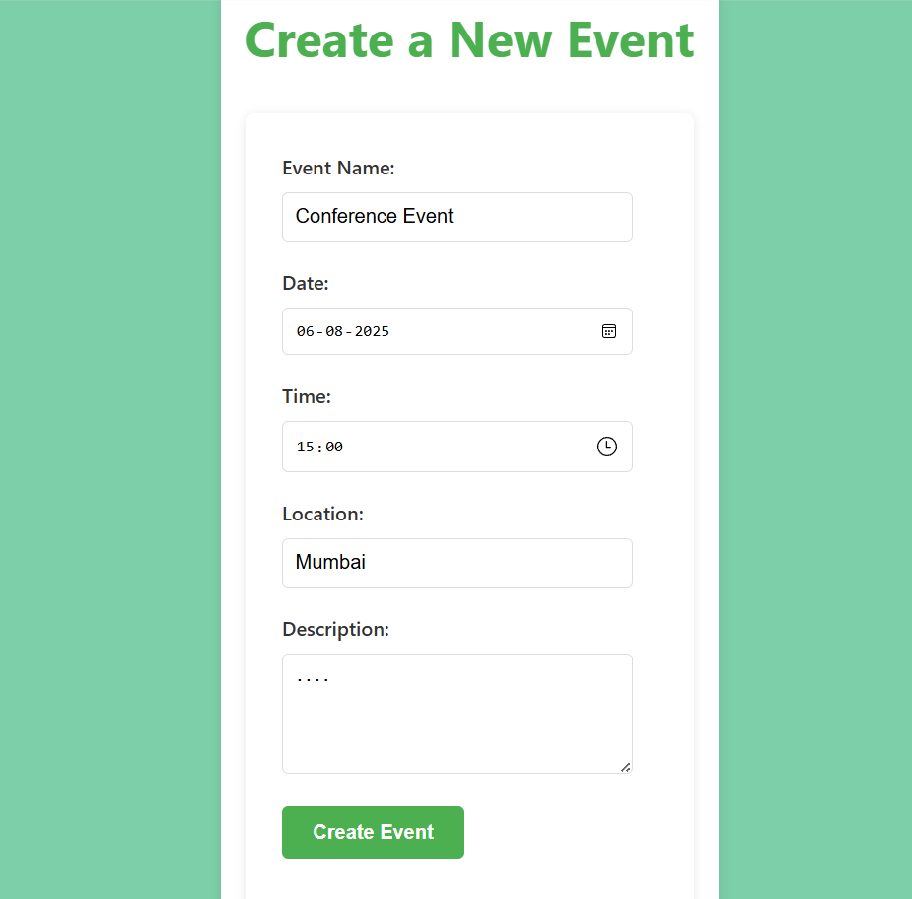
Create a new event
.
.
MAJOR: INTERIOR DESIGN

Slide 8
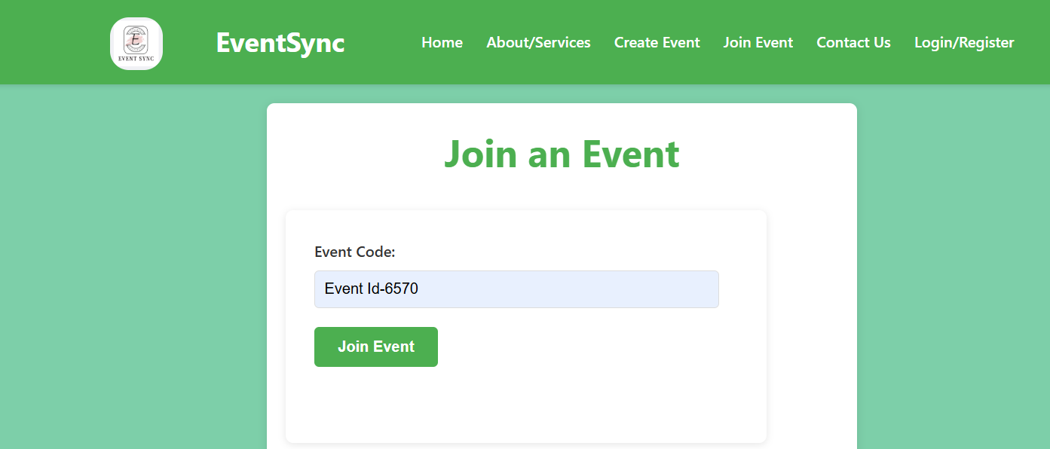
Join an Event
MAJOR: INTERIOR DESIGN

Slide 9
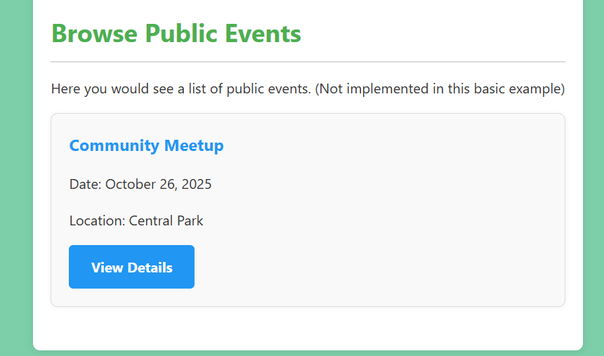
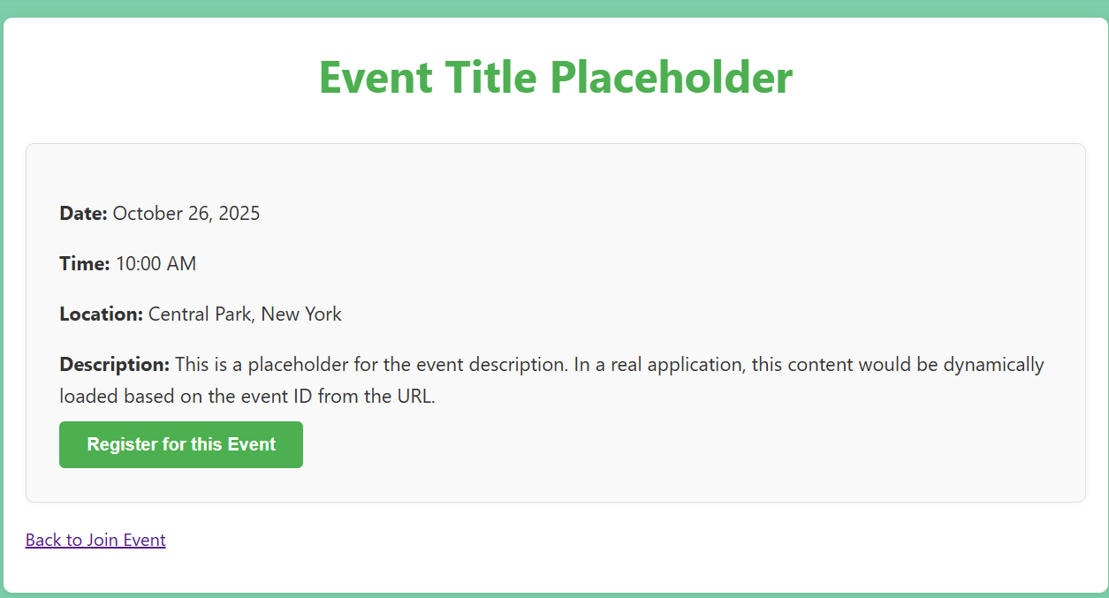
Browse Public Events

Slide 10
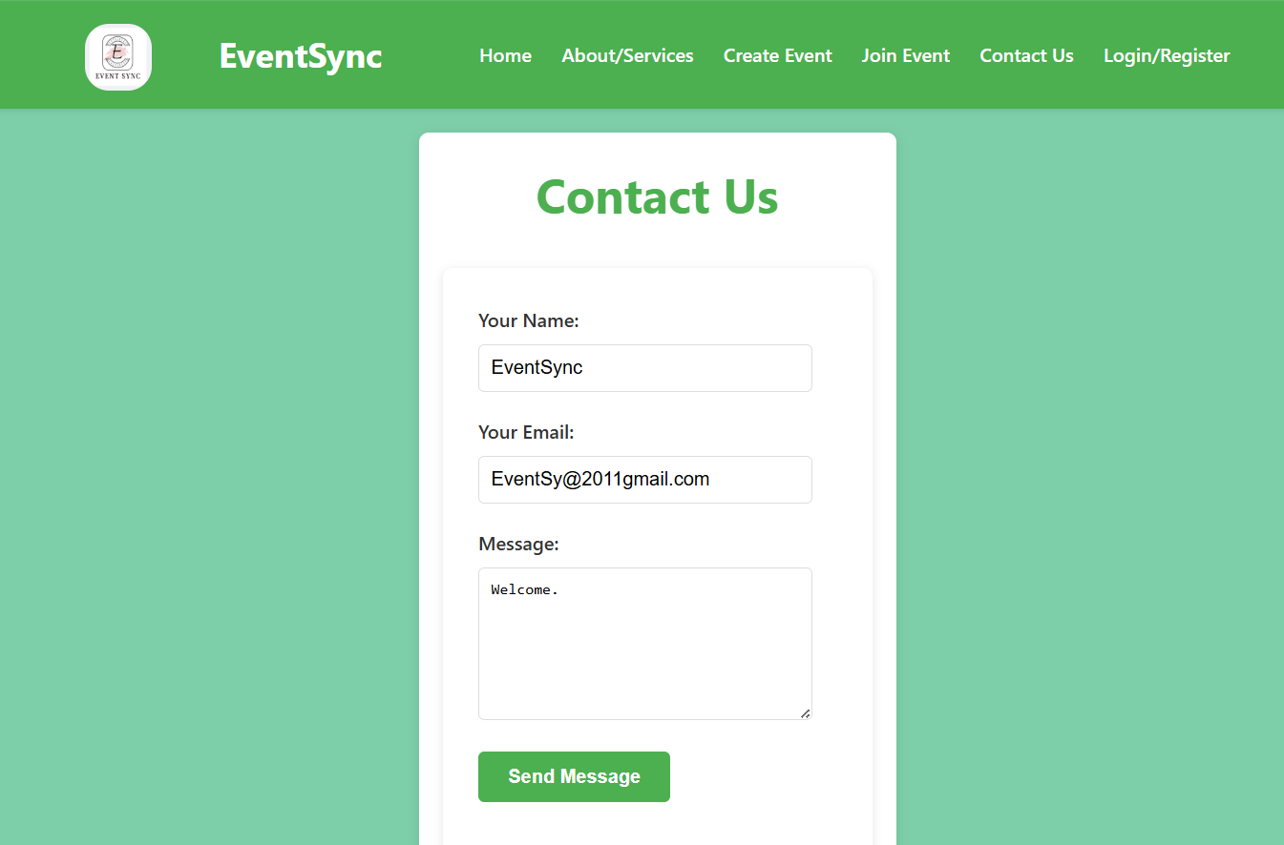

Contact Us
MAJOR: INTERIOR DESIGN

Slide 11
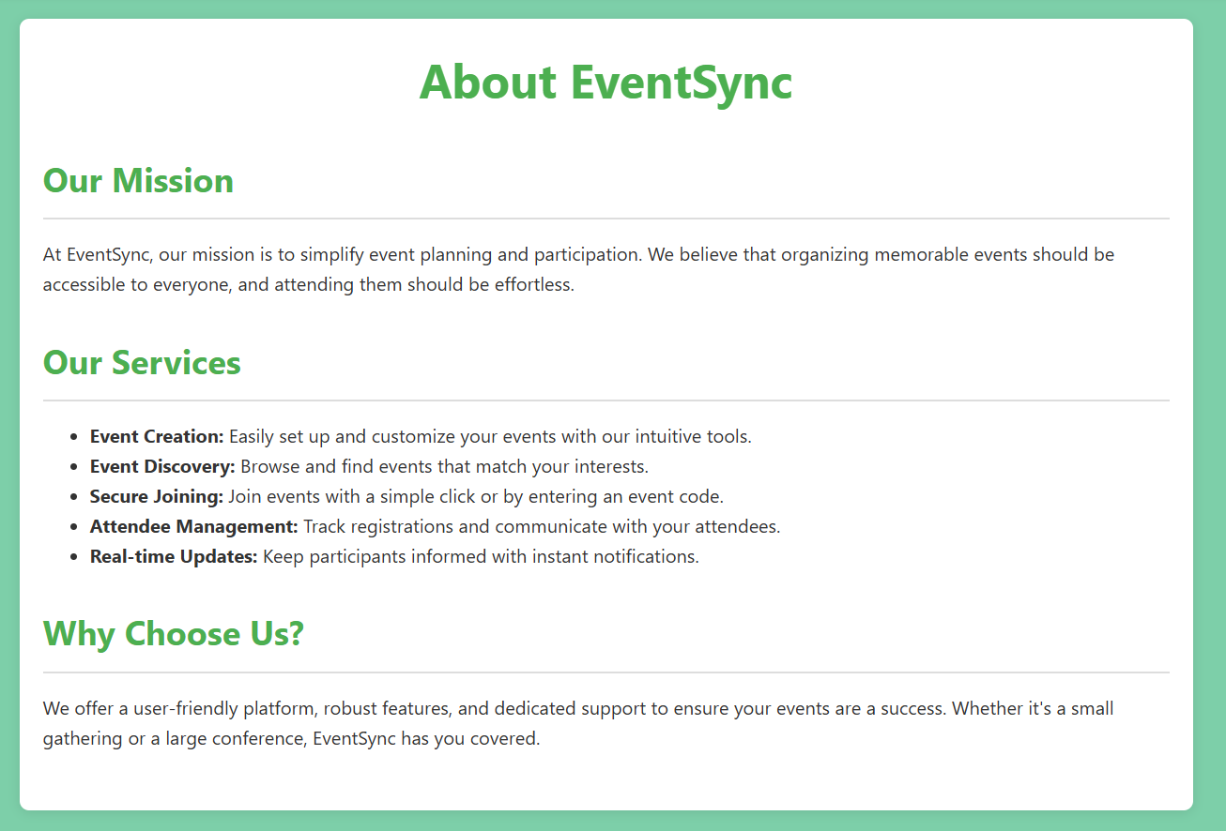
About/Services

Slide 12
User
User_id | INT | NOT_NULL | PRIMARY_KEY
Name | VARCHAR(100) | NOT_NULL | -
Email | VARCHAR(100) | NOT_NULL | UNIQUE
Password | VARCHAR(50) | NOT_NULL | -
Role | ENUM(‘Attendee’,’Organize’) | NOT_NULL | DEFAULT(‘Attendee’)
Created_At | TIMESTAMP | NOT_NULL | DEFAULT(CURRENT_TIMESTAMP)

Slide 13
Event
Event_id | INT | NOT_NULL | PRIMARY_KEY
Organizer_id | INT | NOT_NULL | FOREIGN_KEY User(User_id)
Category_id | INT | NOT_NULL | FOREIGN_KEY Category(Category_id)
Title | VARCHAR(225) | NOT_NULL | -
Description | TEXT | NOT_NULL | -
Location | VARCHAR(225) | NOT_NULL | -
Date | DATE | NOT_NULL | -
Start_Time | TIME | NOT_NULL | -
End_Time | TIME | NOT_NULL | -
Is_Public | BOOLEAN | NOT_NULL | DEFAULT(TRUE)
Created_At | TIMESTAMP | NOT_NULL | DEFAULT(CURRENT_TIMESTAMP)

Slide 14
Event_Registration
Registration_id | INT | NOT_NULL | PRIMARY_KEY
Event_id | INT | NOT_NULL | FOREIGN_KEY Event(Event_id)
User_id | INT | NOT_NULL | FOREIGN_KEY User(User_id)
Date_&_Time | DATETIME | NOT_NULL | -
Registration_Time | TIMESTAMP | NOT_NULL | DEFAULT(CURRENT_TIMESTAMP)
Tickets
Ticket_id | INT | NOT_NULL | PRIMARY_KEY
Registration_id | INT | NOT_NULL | FOREIGN_KEY Event_Registration( Registration_id)
Ticket_code | INT | NOT_NULL | UNIQUE
Issued_At | TIMESTAMP | NOT_NULL | DEFAULT(CURRENT_TIMESTAMP)

Slide 15
Contact_Message
Contact_message_id | INT | NOT_NULL | PRIMARY_KEY
Name | VARCHAR(100) | NOT_NULL | -
Email | VARCHAR(100) | NOT_NULL | -
Message | TEXT | NOT_NULL | -
Sent_At | TIMESTAMP | NOT_NULL | DEFAULT(CURRENT_TIMESTAMP)
Sent_At | TIMESTAMP | NOT_NULL | DEFAULT(CURRENT_TIMESTAMP)

Slide 16
Category
Category_id | INT | NOT_NULL | PRIMARY_KEY
Name | VARCHAR(100) | NOT_NULL | UNIQUE

Slide 17
Sessions
Session_id | INT | NOT_NULL | PRIMARY_KEY
Event_id | INT | NOT_NULL | FOREIGN_KEY Event(Event_id)
Title | VARCHAR(100) | NOT_NULL | -
Speaker | VARCHAR(100) | NOT_NULL | -
Start_Time | TIME | NOT_NULL | -
End_Time | TIME | NOT_NULL | -

Slide 18
Notification
Notification_id | INT | NOT_NULL | PRIMARY_KEY
User_id | INT | NOT_NULL | FOREIGN_KEY User(User_id)
Event_id | Int | NOT_NULL | FOREIGN_KEY Event(Event_id)
Message | TEXT | NOT_NULL | -
Sent_At | TIMESTAMP | NOT_NULL | DEFAULT(CURRENT_TIMESTAMP)

Slide 19
Feedback
Feedback_id | INT | NOT_NULL | PRIMARY_KEY
Event_id | INT | NOT_NULL | FOREIGN_KEY Event(Event_id)
Name | VARCHAR(100) | NOT_NULL | -
Phone_No. | INT(32) | NOT_NULL | -
Email | VARCHAR(100) | NOT_NULL | -
Comment | TEXT | NOT_NULL | -

Slide 20
I
THANK YOU
For your attention

